Slide 1
INDUSTRIAL AND VEHICULAR AUTOMATION
BY CHALLA SAI BHARATH
312217106032

Slide 2
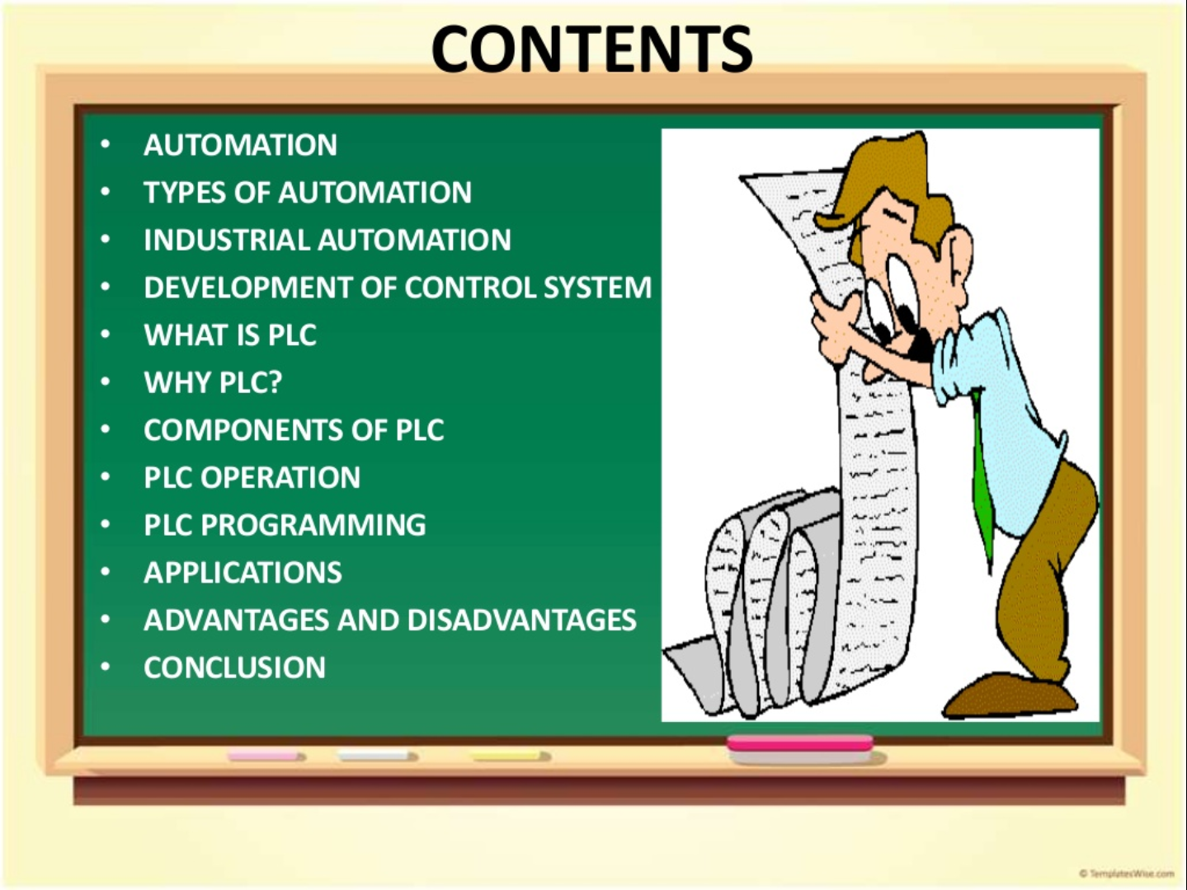

Slide 3
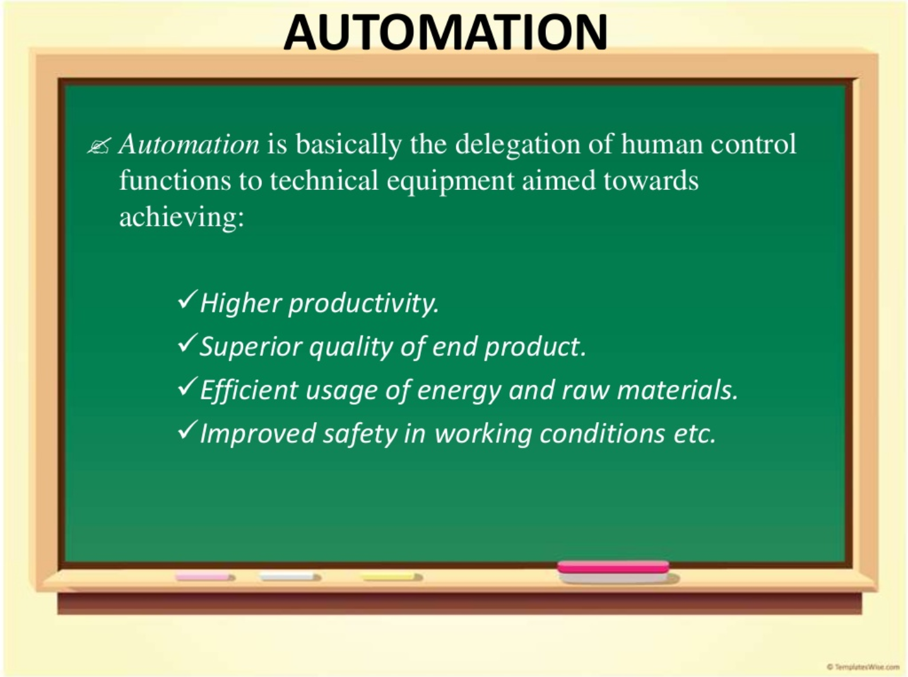

Slide 4
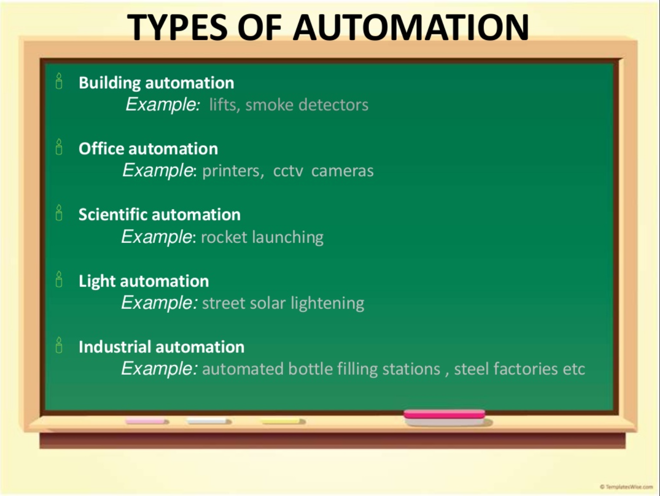

Slide 5

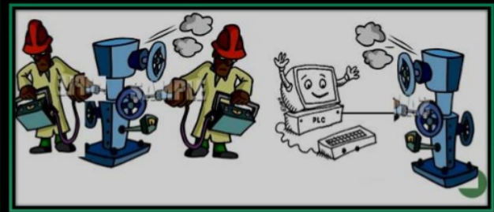
WHAT IS PLC? WHY PLC?
“Programmable Logic Controller(PLC) is an industrial computer that monitors inputs , makes decision based on its program and controls outputs to automate a process or machine.”
Plc’s are small computers which control the machine.
WHY?
To reduce human efforts.
To get maximum efficiency from machine and control them using human logic.
cost efficient .Machine can be controlled by PLC without human efforts.

Slide 6
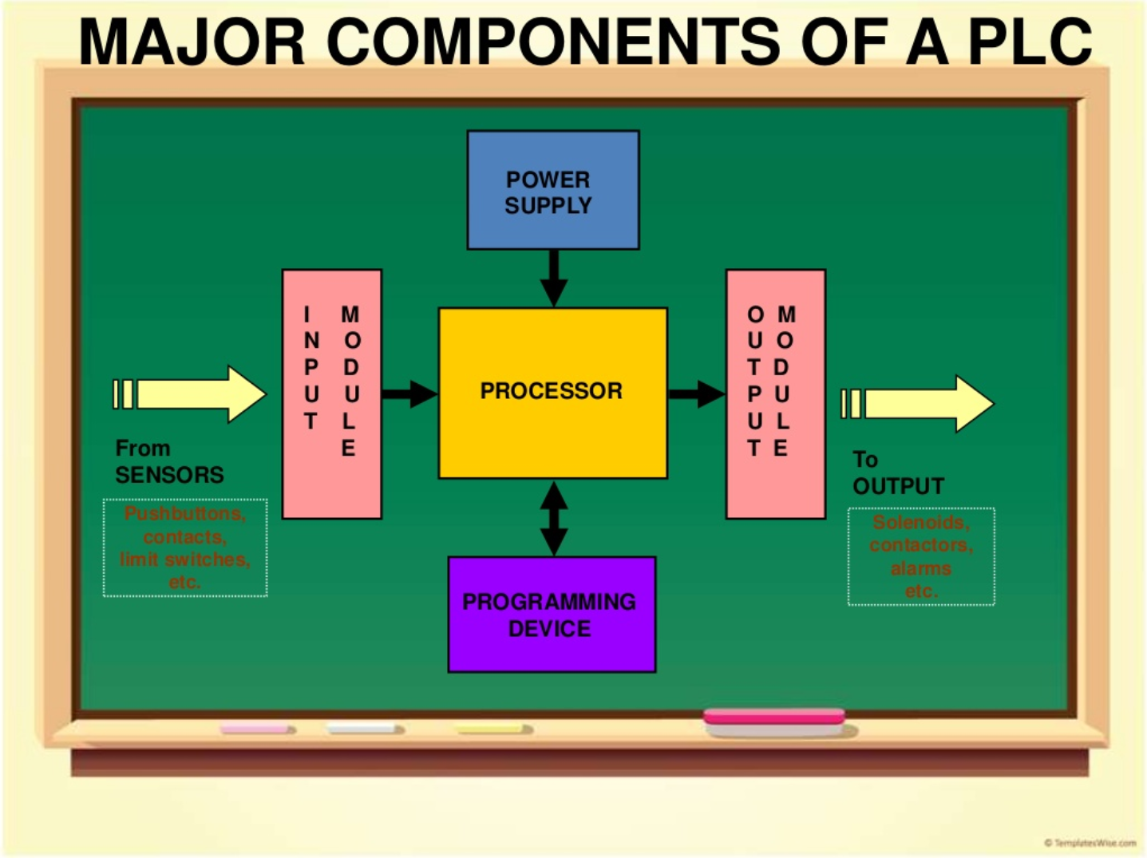

Slide 7
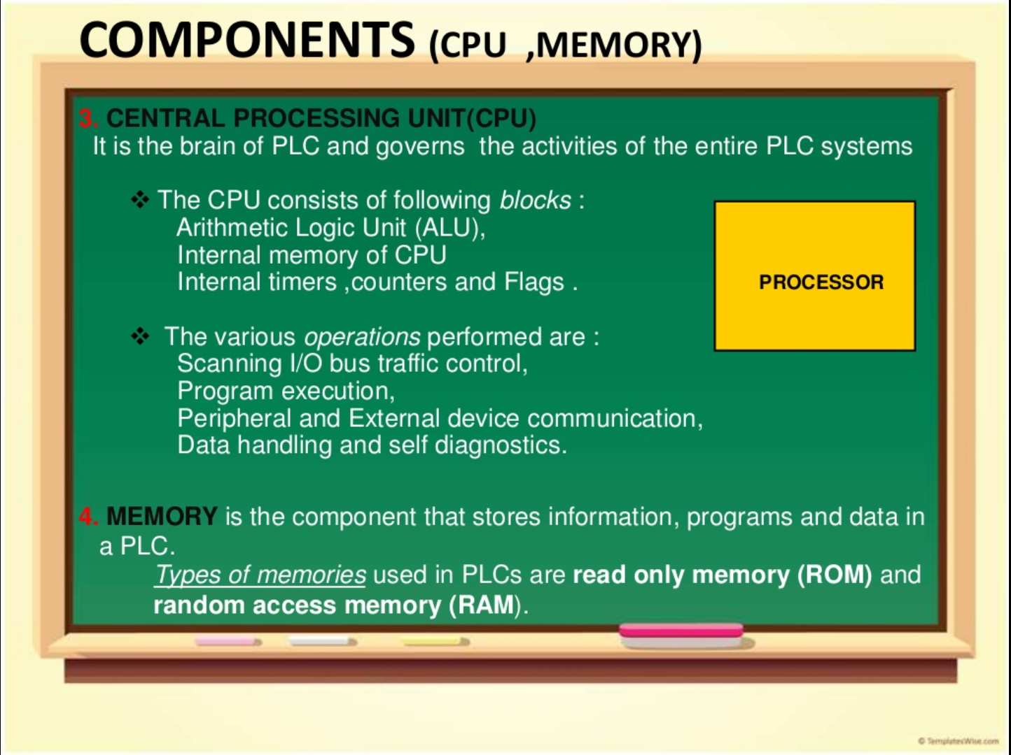

Slide 8
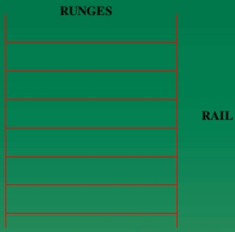
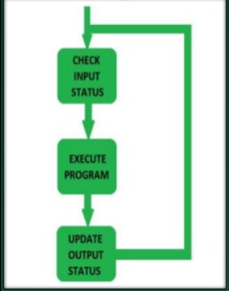
PLC OPERATION AND PROGRAMMING LADDER LOGIC is programming language used to develop software for PLC used in industrial applications.

Slide 9




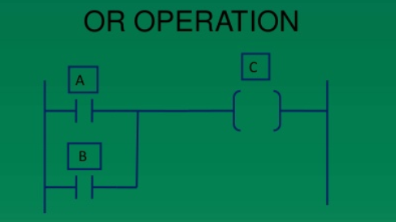
LADDER LOGIC:
ELEMENTS:
EXAMPLE: In the below diagram ,it can be seen that if either A or B or both A and B are TRUE , then the output is TRUE.

Slide 10
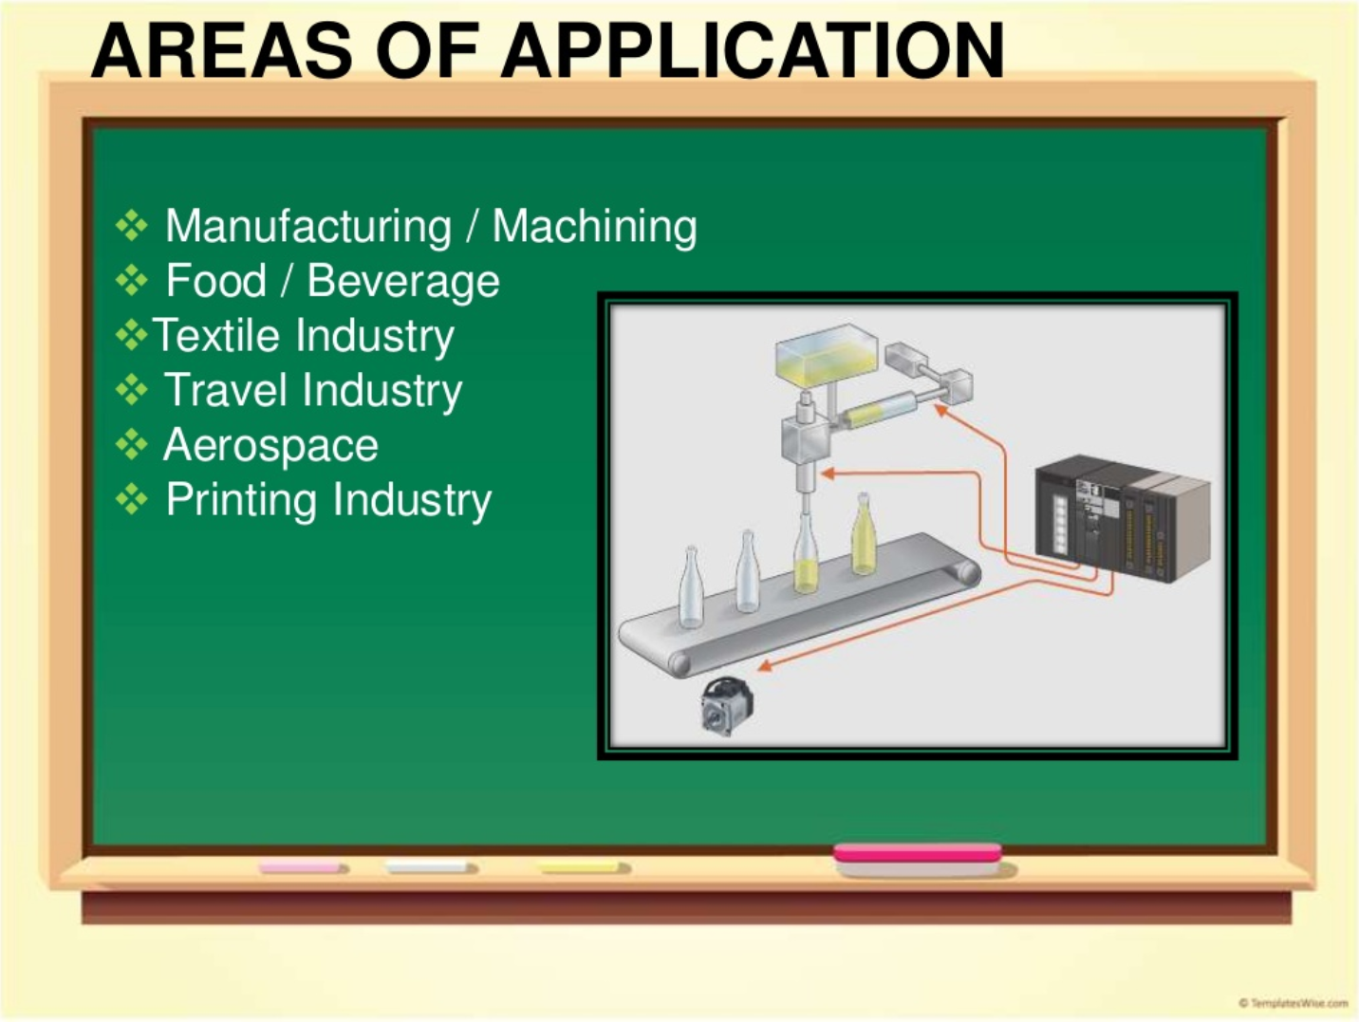

Slide 11
ADVANTAGES AND DISADVANTAGES:
ADVANTAGES
DISADVANTAGES
Replacing human operations , dangerous environments,beyond human capabilities.
Fast
Easily programmable using ladder logic
Improves quality
Improves productivity
Initial cost is high.
Unemployment rate increases.
Mainrtainence is costly.

Slide 12
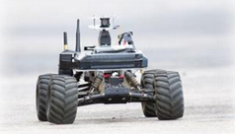
VEHICULAR AUTOMATION:
• Vehicular automation involves the use of
✓Mechatronics
✓Artificial Intelligence
✓Multi-agent System
to assist a vehicle's operator.
• These features and the vehicles employing them may be labeled as
intelligent or smart.
• A vehicle using automation for difficult tasks, especially navigation,
may be referred to as semi-autonomous.

Slide 13
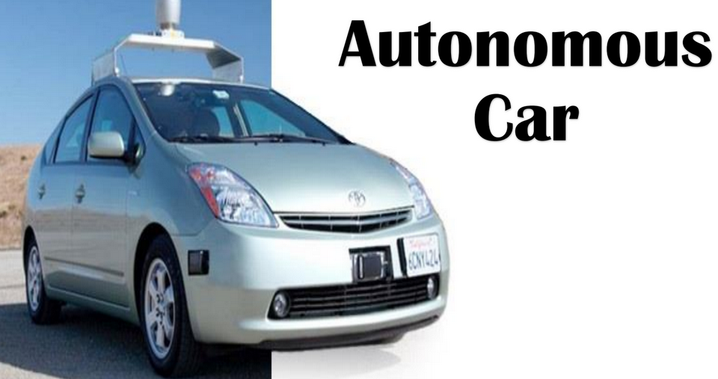
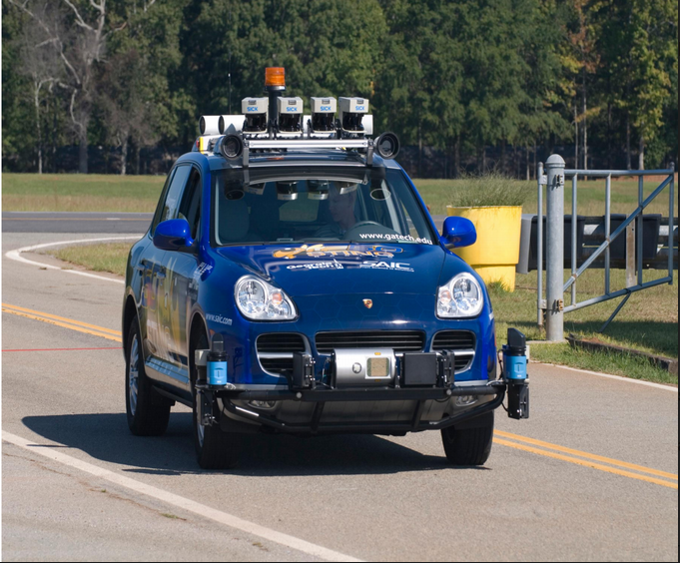
AUTONOMOUS CAR AS AN EXAMPLE:
• An autonomous car is an
autonomous vehicle capable of
fulfilling the human transportation
capabilities of a traditional car.
• As an autonomous vehicle, it is
capable of sensing its environment
and navigating without human input.
AUTONOMOUS CAR DESIGNED BY GEROGIA TECH.

Slide 14
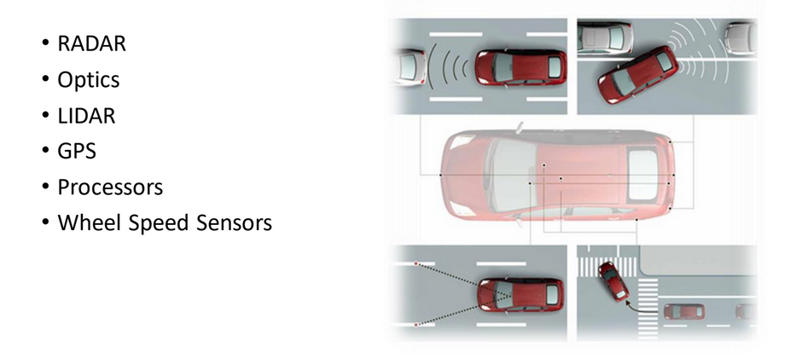
VEHICLE HARDWARE:

Slide 15
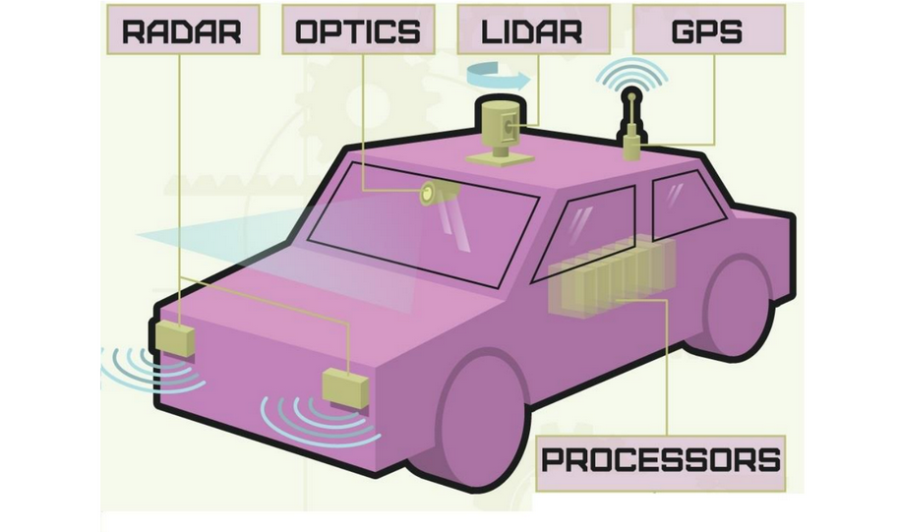

Slide 16
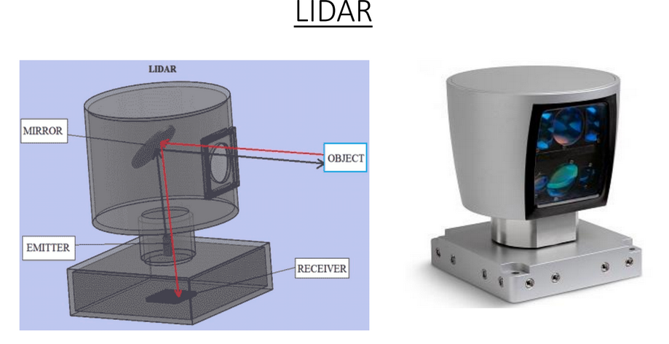
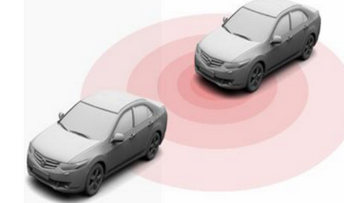
• Traditional RADAR sensors are used to detect dangerous objects in the vehicle’s path that are more than 100 meters away.
• The Light Detection And Ranging (LIDAR) which is mounted on the roof of the vehicle is the most important device in the Autonomous vehicles. The LIDAR consists of an emitter, mirror and receiver. The vehicle can then generate a map of its surroundings and use the map to avoid objects.

Slide 17
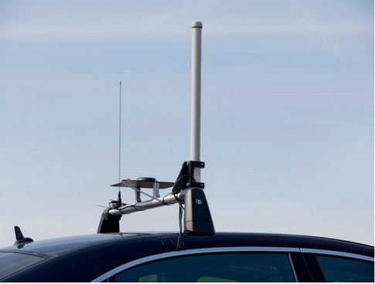
GPS:
• A Global Positioning System keeps the car on its intended route with an accuracy of 30 centimeters. With GPS covering the macro location of car, smaller on-deck cameras can recognize smaller details like red lights, stop signs and construction zones.
Processors:
• Some 7 dual-core 2.13 GHz processors and 2Gb of RAM are needed to
make sense of the data collected by the car’s instruments.
WHEEL SPEED SENSOR:
• Wheel Speed Sensors measure the
road-wheel speed and direction of
rotation.

Slide 18
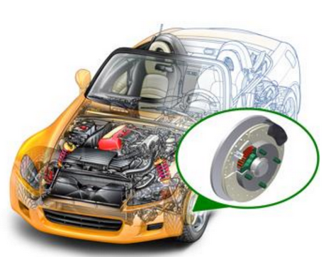
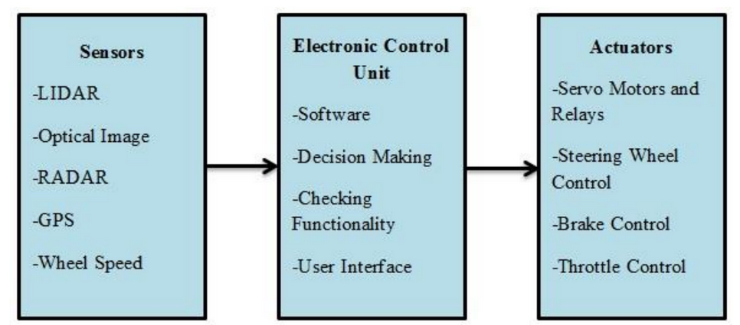
Working

Slide 19
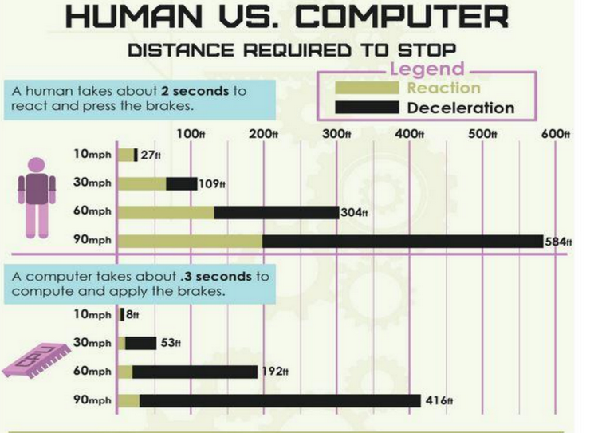

Slide 20
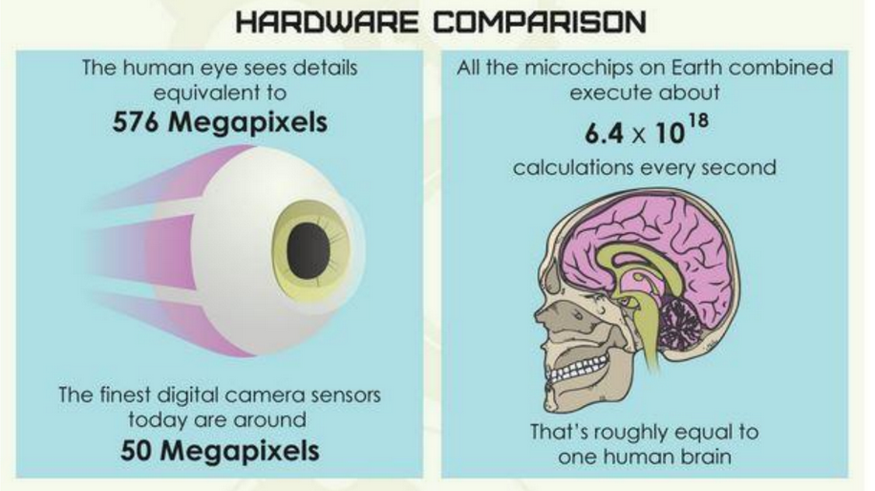

Slide 21
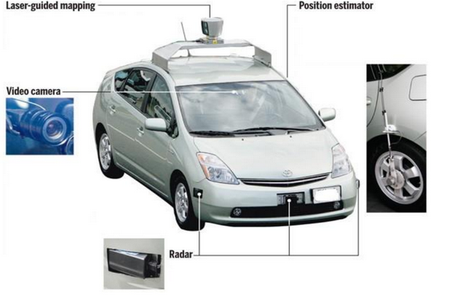
ADVANTAGES AND OBSTACLES:
ADVANTAGES
OBSTACLES
Fewer traffic collisions
Increased roadway capacity and reduced traffic congestion.
Higher speed limit for autonomous cars.
Smoother ride and tireless ride.
Loss of driver-related jobs.
Autonomous cars relying on lane markings cannot decipher faded, missing, or incorrect lane marks.
Loss of privacy.

Slide 22
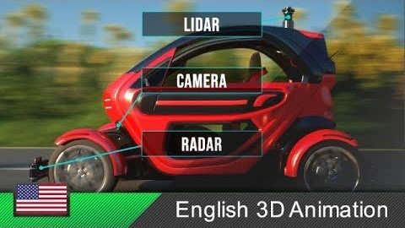

Slide 23

THANK YOU FOR YOUR PATIENCE.
.

